Slide 1
Understanding Measures of Central Tendency and Dispersion in Data Analysis
Key statistics concepts for effective data interpretation
Notes:
AI-generated content may be incorrect. --- This presentation introduces key statistical concepts: measures of central tendency and dispersion. We will explore how these measures summarize data distributions and help interpret data effectively in various contexts.

Slide 2
Meeting Program
Exploring Measures of Central Tendency
Comparing Mean, Median, and Mode
Measures of Dispersion: Variance and Standard Deviation
Applying Central Tendency and Dispersion in Data Interpretation
Notes:
We will first examine the measures of central tendency, including mean, median, and mode. Next, we'll compare these measures and discuss their strengths and limitations. Then, we'll explore measures of dispersion such as variance and standard deviation. Finally, we will discuss how to apply these concepts in real-world data analysis.

Slide 3
Exploring Measures of Central Tendency
Notes:
Measures of central tendency summarize a dataset by identifying its center point or typical value. This section covers mean, median, and mode, explaining their definitions, calculations, and when to use each measure.

Slide 4

Definition and Significance of Mean (Average)
Mean Calculation
The mean is calculated by summing all numbers and dividing by the total count of values.
Central Location Measure
The mean indicates the central location of a data set, summarizing data with a single value.
Sensitivity to Extremes
The mean can be influenced significantly by extreme values or outliers in the data set.
Notes:
--- The mean is the arithmetic average of a set of numbers, calculated by summing all values and dividing by the count. It provides a measure of the central location of data but can be sensitive to extreme values. Image source: Microsoft 365 content library

Slide 5
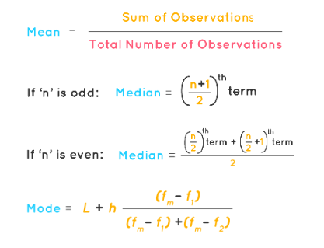
Understanding Median and Its Relevance with Skewed Data
Definition of Median
Median is the middle value in an ordered data set, dividing it into two equal halves.
Resistance to Outliers
Median is unaffected by extreme values, making it more reliable than the mean for skewed data.
Suitability for Skewed Data
Median accurately represents the center in asymmetrical or skewed distributions, unlike mean.
Notes:
--- The median is the middle value when data points are ordered. It is resistant to outliers and skewed distributions, making it ideal for representing the center in asymmetrical data. Image source: Microsoft 365 content library

Slide 6
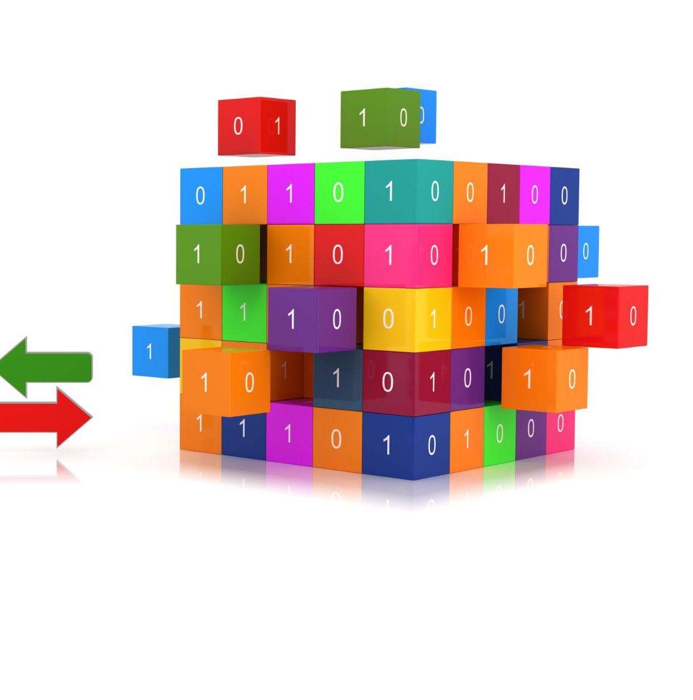
Identifying Mode and Its Application to Categorical Data
Definition of Mode
Mode is the value that appears most frequently in a dataset, representing the most common occurrence.
Usefulness for Categorical Data
Mode is especially useful for categorical data where mean and median cannot be applied meaningfully.
Identifying Common Categories
Mode helps identify the most common category, providing insight into the dataset's primary characteristic.
Notes:
--- The mode is the most frequently occurring value in a dataset. It is especially useful for categorical data where mean and median are not meaningful, helping identify the most common category. Image source: Microsoft 365 content library

Slide 7
Comparing Mean, Median, and Mode
Notes:
This section compares the three measures of central tendency, highlighting their strengths, limitations, and how to choose the appropriate measure depending on data type and distribution.

Slide 8
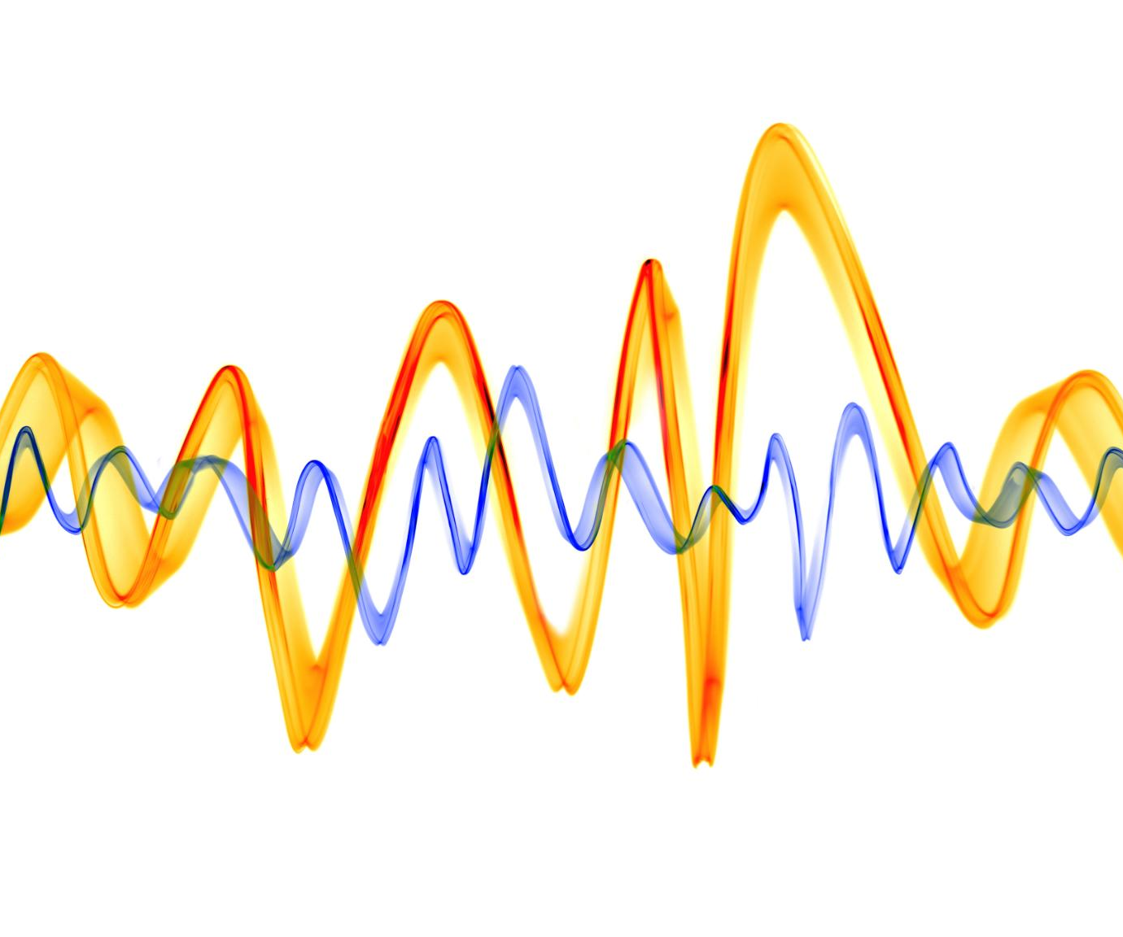
Strengths and Limitations of Each Measure
Mean Sensitivity
The mean is affected by outliers, making it less reliable for skewed data.
Median Robustness
The median resists skewness, providing a better central value for skewed distributions.
Mode for Categories
The mode is ideal for categorical data, representing the most frequent category.
Notes:
--- Mean is sensitive to outliers, median is robust against skewness, and mode is best for categorical data. Understanding these characteristics helps in selecting the most representative measure. Image source: Microsoft 365 content library

Slide 9

Choosing the Appropriate Measure Based on Data Distribution
Mean for Symmetric Data
Mean is the preferred measure for symmetric distributions, offering a balanced average of data points.
Median for Skewed Data
Median provides a reliable central value for skewed data by minimizing the effect of outliers.
Mode for Categorical Data
Mode is ideal for categorical variables, indicating the most frequently occurring category.
Notes:
--- For symmetric distributions, mean is preferred; for skewed data, median is more reliable; mode is ideal for categorical variables. This choice ensures accurate data representation. Image source: Microsoft 365 content library

Slide 10
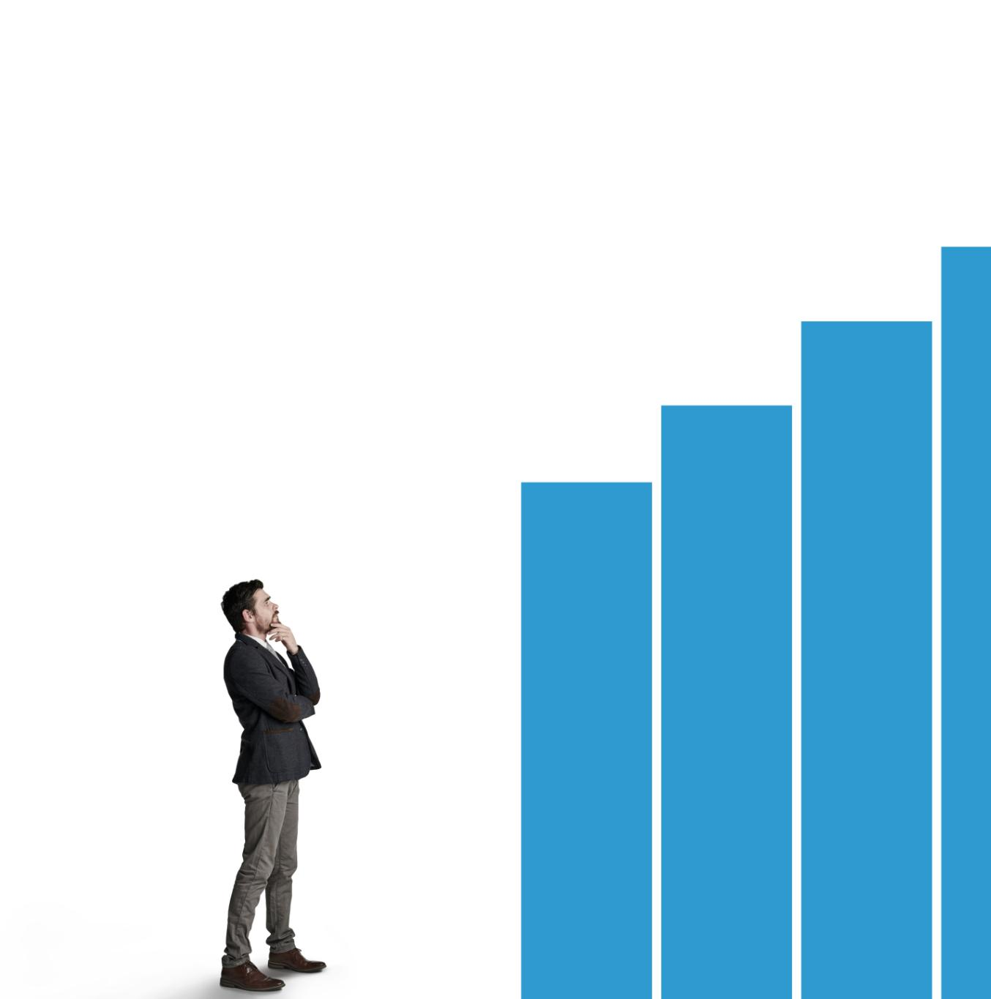
Real-Life Examples Illustrating the Best Use for Each Measure
Mean for Average Scores
Mean is ideal for calculating average test scores to represent overall performance effectively.
Median for Income Data
Median is used for income data with high inequality to represent the typical income without extremes.
Mode for Common Products
Mode identifies the most common product sold, highlighting popular consumer choices.
Notes:
--- Examples include using mean for average test scores, median for income data with high inequality, and mode for the most common product sold, demonstrating practical applications. Image source: Microsoft 365 content library

Slide 11
Measures of Dispersion: Variance and Standard Deviation
Notes:
Dispersion measures describe the spread or variability of data points around the central tendency. This section introduces variance and standard deviation as key indicators of data variability.

Slide 12
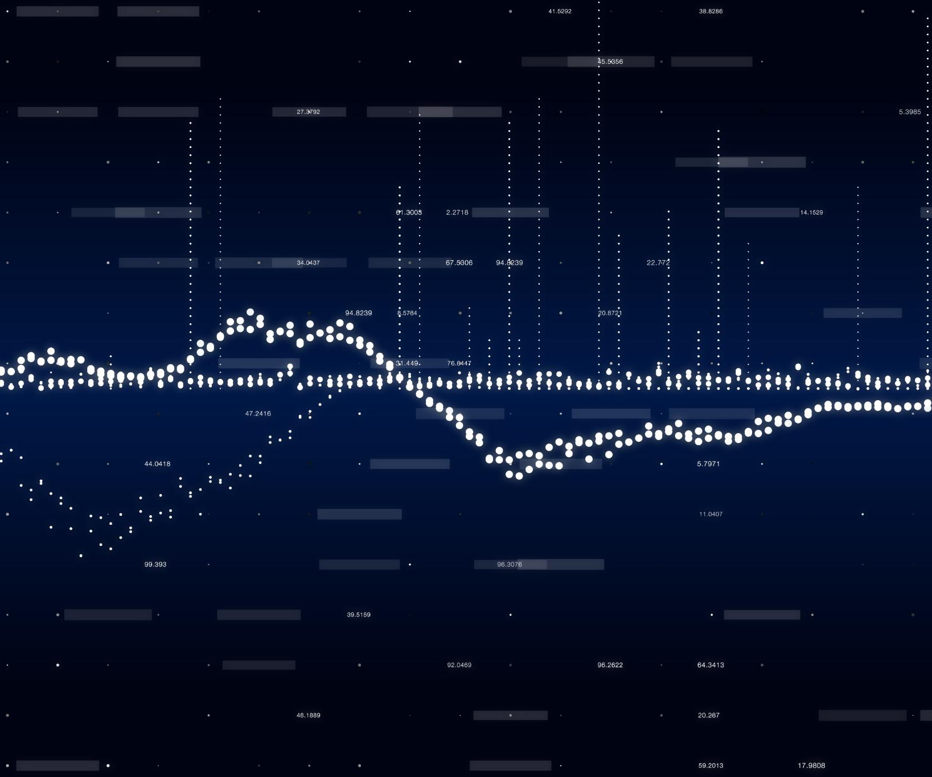
Definition and Calculation of Variance
Variance Concept
Variance represents the average of squared differences from the mean in a data set.
Spread Measurement
Variance quantifies the spread or dispersion of data values around the mean.
Squared Units Explanation
Variance is expressed in squared units, which can make interpretation less intuitive.
Notes:
--- Variance measures the average squared deviation of each data point from the mean. It quantifies how spread out the data is but is expressed in squared units, which can be less intuitive. Image source: Microsoft 365 content library

Slide 13
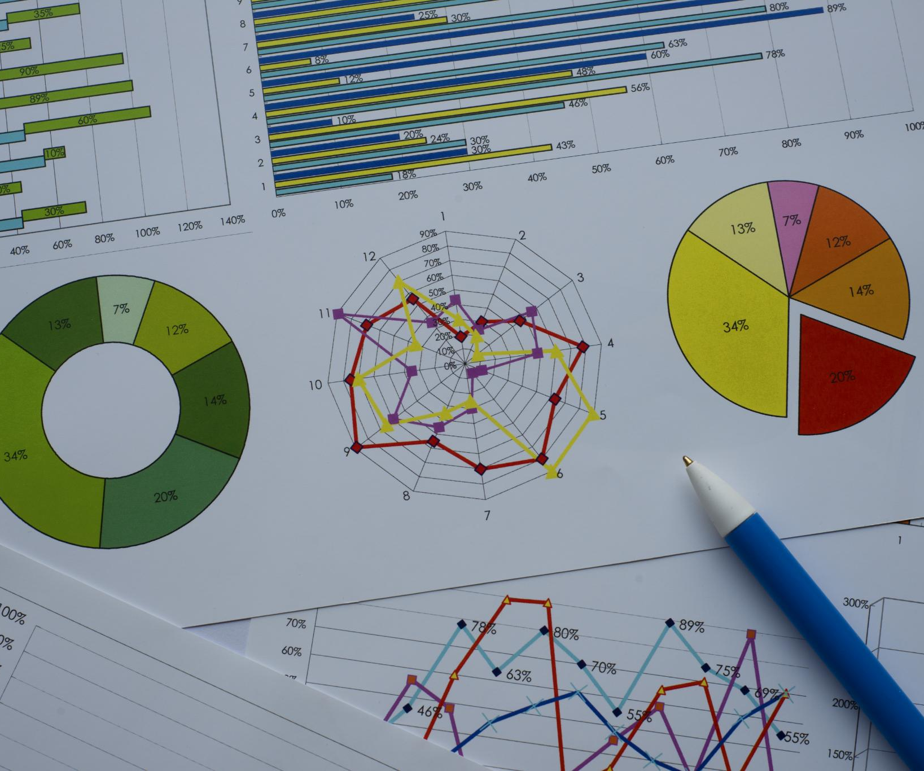
Role of Variance in Statistical Analysis
Assessing Data Consistency
Variance measures the spread of data points, helping evaluate the consistency within a dataset.
Outlier Detection
Variance aids in identifying data points that deviate significantly from the average, highlighting potential outliers.
Foundation for Inferential Statistics
Variance is fundamental to many inferential statistical methods used to make conclusions about populations from samples.
Notes:
--- Variance helps assess data consistency, detect outliers, and underpins many inferential statistics methods, making it essential for understanding data reliability and differences. Image source: Microsoft 365 content library

Slide 14
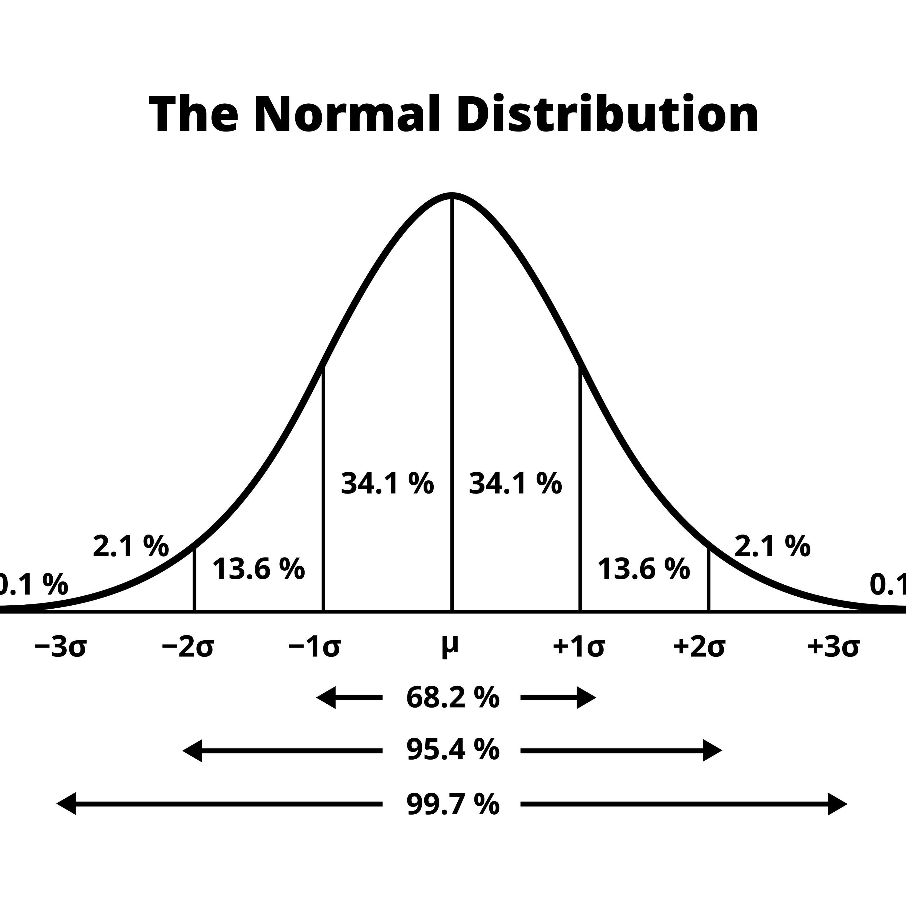
Understanding Standard Deviation and Its Practical Meaning
Definition of Standard Deviation
Standard deviation is the square root of variance, measured in the same units as the original data set.
Measure of Data Variability
It quantifies typical deviation from the mean, showing how spread out data points are in a dataset.
Practical Interpretation
Standard deviation helps interpret data consistency and variability in practical, real-world contexts.
Notes:
--- Standard deviation is the square root of variance, expressed in the same units as the data. It provides a direct measure of typical deviation from the mean, helping to interpret data variability easily. Image source: Microsoft 365 content library

Slide 15
Applying Central Tendency and Dispersion in Data Interpretation
Notes:
Combining measures of central tendency and dispersion enables comprehensive understanding of datasets. This section discusses strategies for analyzing different data distributions and addressing outliers.

Slide 16
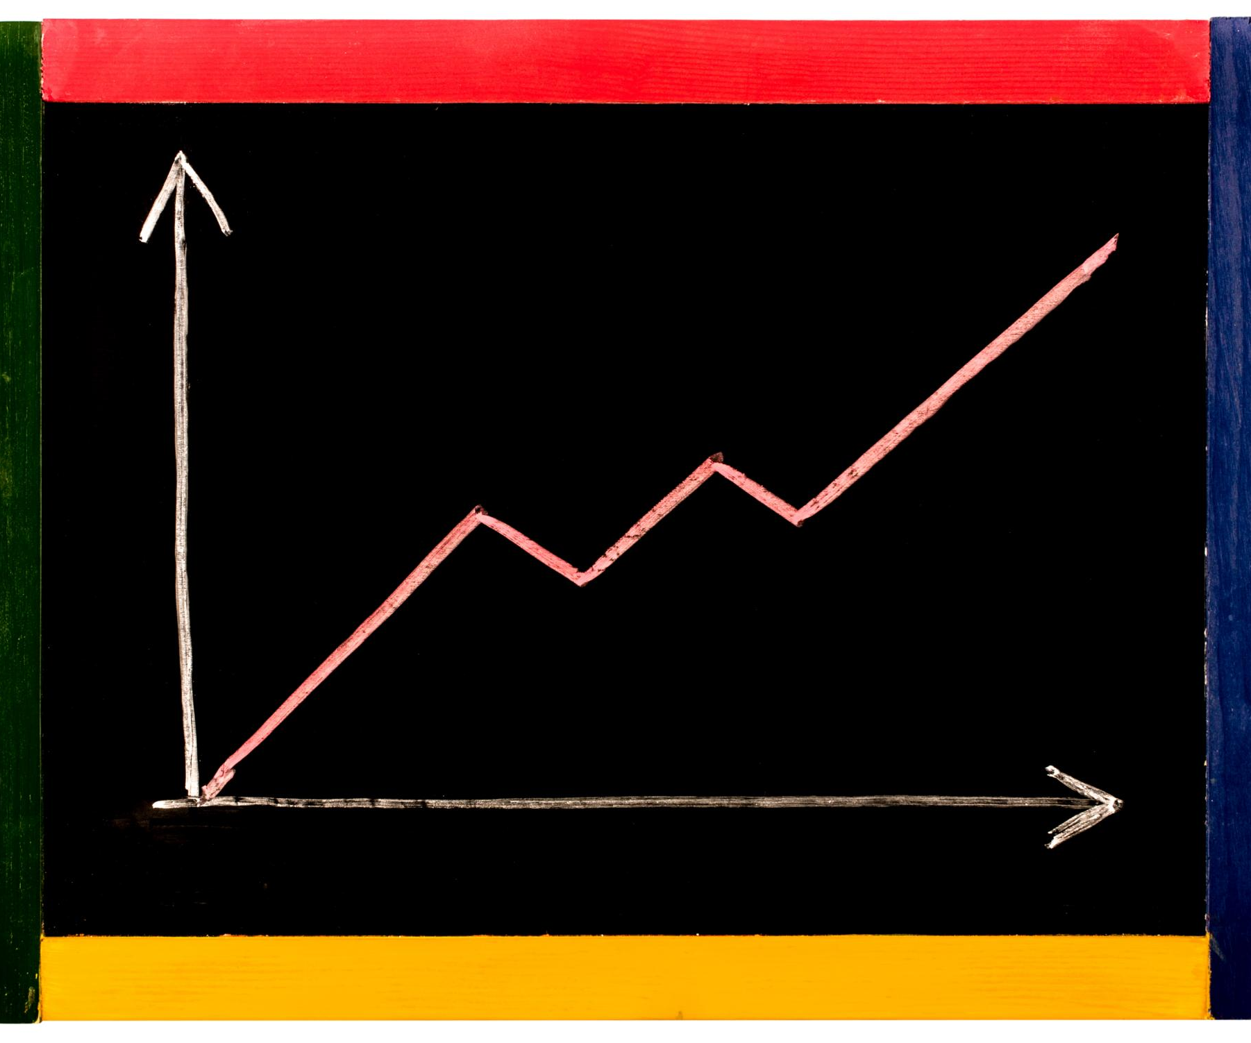
Analyzing Symmetrically Distributed versus Skewed Data
Symmetric Data Analysis
Symmetric data distributions are best summarized using mean and standard deviation to describe central tendency and variability.
Skewed Data Analysis
Skewed data requires median and interquartile range for meaningful interpretation due to asymmetry.
Notes:
--- Symmetric data allows use of mean and standard deviation, while skewed data requires median and interquartile range for accurate interpretation, ensuring meaningful statistical summaries. Image source: Microsoft 365 content library

Slide 17
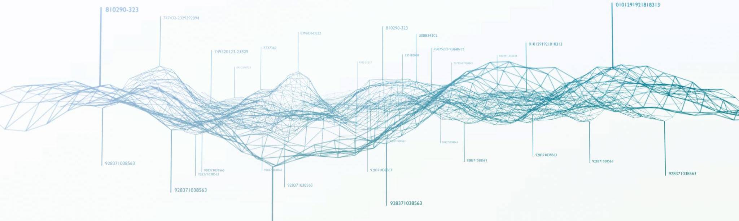
Dealing with Outliers and Their Impact on Statistical Measures
Effect of Outliers
Outliers can distort key statistics like means and variances, leading to misleading conclusions.
Outlier Identification
Proper detection methods help identify outliers and prevent their negative impact on analysis.
Robust Statistical Measures
Using median or trimmed means reduces sensitivity to outliers and enhances analysis robustness.
Notes:
--- Outliers can distort means and variances. Identifying and managing outliers, such as using median or trimmed means, improves the robustness of data analysis. Image source: Microsoft 365 content library

Slide 18

Using These Measures in Real-World Decision Making
Data-Driven Business Decisions
Applying statistical measures helps businesses analyze trends and make informed strategic decisions effectively.
Healthcare Insights
Statistical analysis supports healthcare professionals in understanding patient data and improving treatment outcomes.
Research and Interpretation
Researchers use statistical measures to accurately summarize data patterns and validate hypotheses scientifically.
Notes:
--- Understanding and applying these statistical measures supports data-driven decisions in business, healthcare, and research by accurately summarizing and interpreting data patterns. Image source: Microsoft 365 content library

Slide 19
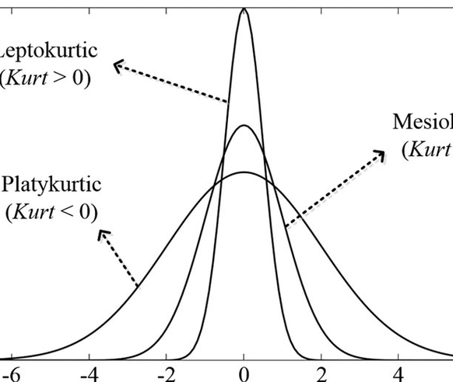
Understanding Skewness & Kurtosis
What is Skewness?
Skewness shows the asymmetry in a data distribution, highlighting if data cluster more on one side of the mean.
Types of Skewness
Positive skew has a longer right tail, while negative skew has a longer left tail in the distribution.
What is Kurtosis?
Kurtosis measures 'tailedness', indicating how often extreme values occur in the data set.
High vs. Low Kurtosis
High kurtosis means more outliers and a sharp peak; low kurtosis means fewer outliers and a flatter shape.
Notes:
Image source: Microsoft 365 content library Skewness measures the asymmetry of a data distribution, showing if data are concentrated more on one side of the mean. Positive skew has a longer right tail; negative skew, a longer left tail. Kurtosis quantifies 'tailedness,' indicating the frequency of extreme values. High kurtosis means more outliers and a sharper peak, while low kurtosis suggests fewer outliers and a flatter shape.

Slide 20
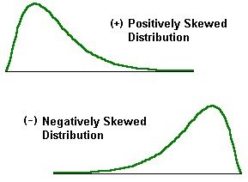
Skewness and Central Tendency
Understanding Skewness
Skewness indicates whether a data distribution is asymmetric. Positive and negative skewness reveal how data tails behave.
Relationship Between Mean, Median, and Mode
In positively skewed data, the mean is greater than the median and mode. In negatively skewed data, the mean is less.
Impact on Data Interpretation
Skewness pulls the mean toward the tail, while median and mode show the data's peak and central location.
Notes:
Image source: Microsoft 365 content library Skewness measures the asymmetry of a data distribution. In positively skewed data, the mean is higher than the median and mode, while in negatively skewed data, the mean is lower. Skewness affects data interpretation, as the mean is pulled toward the tail, whereas the median and mode reflect the peak and central location of the data.

Slide 21
Conclusion
Foundational Statistical Tools
Central tendency and dispersion measures are essential for summarizing and understanding data distributions.
Choosing Appropriate Measures
Selecting the right measure depends on the data type and characteristics for accurate analysis.
Effective Decision-Making
Using accurate statistical measures supports reliable insights and better business or research decisions.
Notes:
Measures of central tendency and dispersion are foundational tools in data analysis. Choosing the right measure based on data characteristics ensures accurate insights and effective decision-making.

